Slide 1
Using Blockchain
Crowdfunding
Presented By:
•Prajwal Deshpande

Slide 2
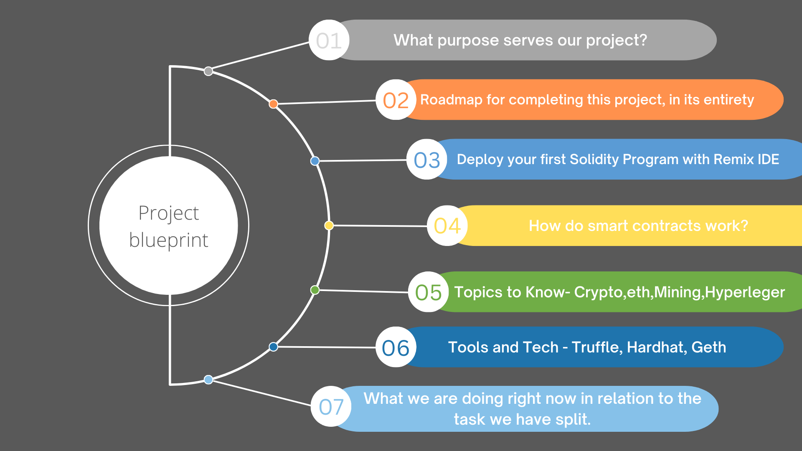

Slide 3
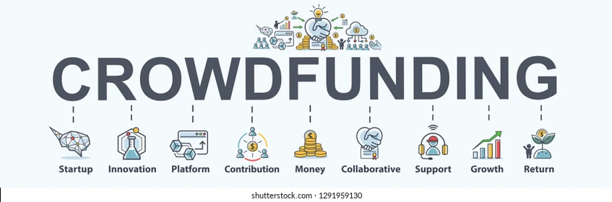
Crowdfunding

Slide 4
The main purpose of our project -
Trust
Transparency
Peer_to_Peer
Security
Payment
Voting

Slide 5
Idea behind to build a Decentralized crowdfunding application on the Ethereum blockchain platform
why we use blockchain in crowdfunding
How does BlockChain support Crowdfunding ?
Why Donate crypto?
Traditional fundraising problem
01
02
Credibility, attract huge funds
Access Equity, Universal Opportunity
03
04
trace funds, intended destination
No generate, scams are on the rise

Slide 6
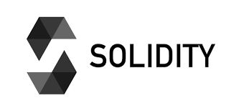
What is solidity ?
Why we use solidity?
What are some important features of Solidity?
What types of applications can be developed using Solidity?

Slide 7
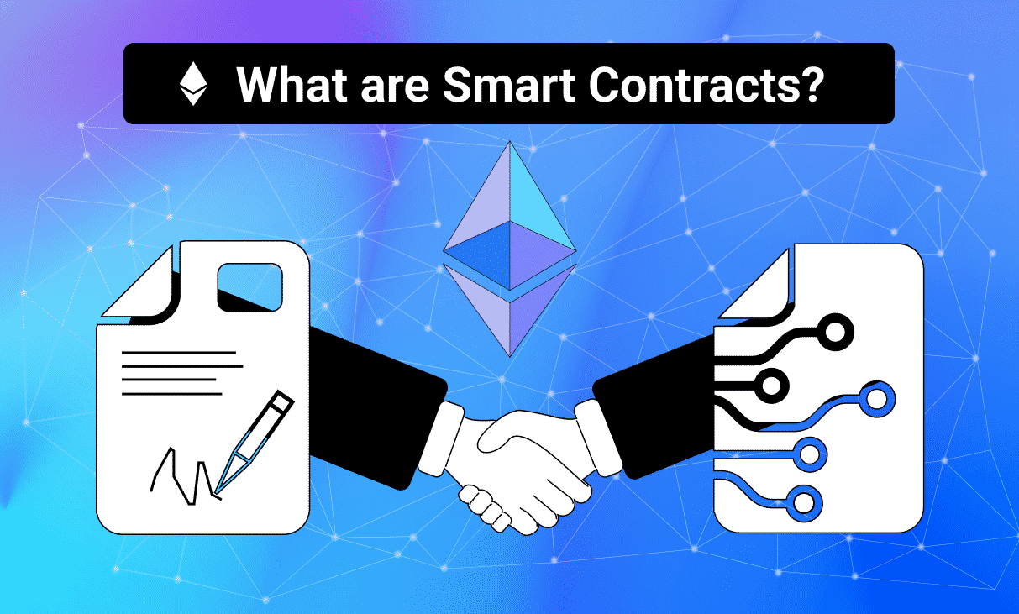
smart contract
What are Smart Contracts?
Can Smart Contracts Be Trusted?
How does smart contract works?
What are the challenges of smart contracts?

Slide 8
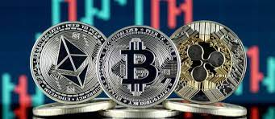
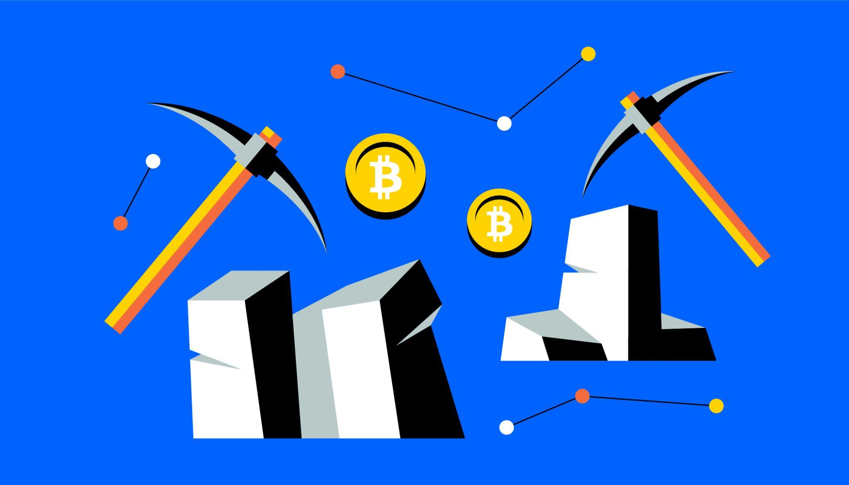
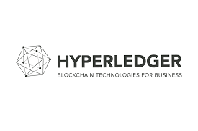
Topics to know -

Slide 9
Tools and tech -
01
02
03
Truffle
Hardhat
Geth

Slide 10
—SOMEONE FAMOUS
“We have elected to put our money and faith in a mathematical framework that is free of politics and human error. ..”

Slide 11
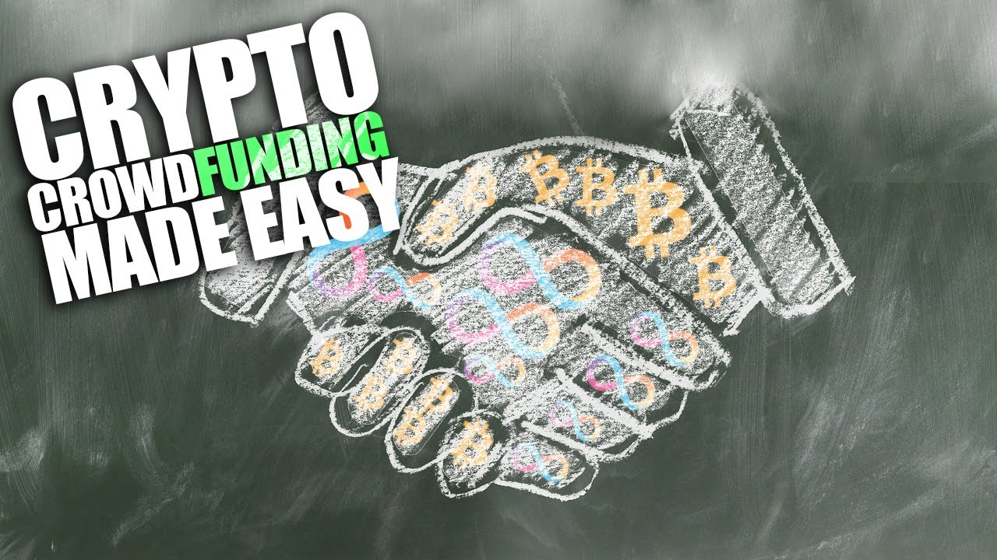

Slide 12

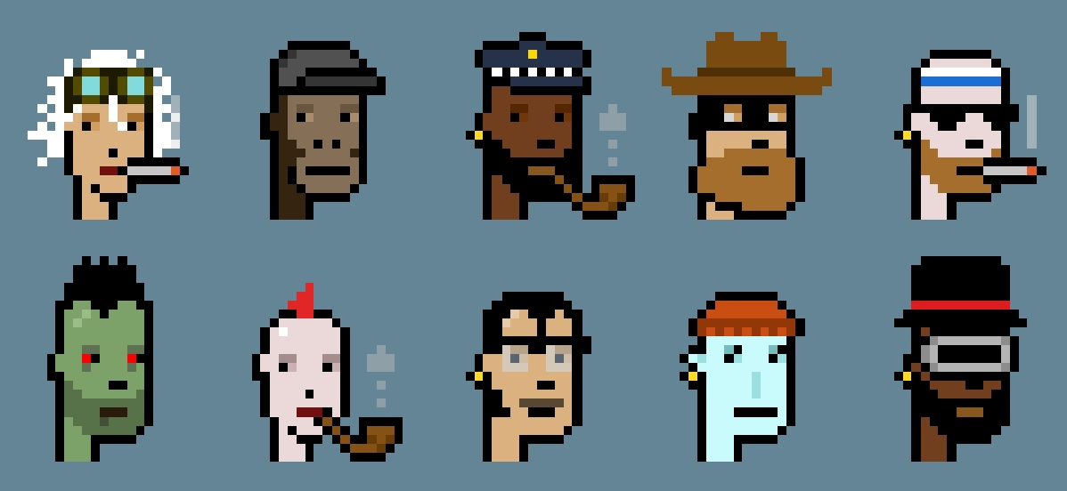
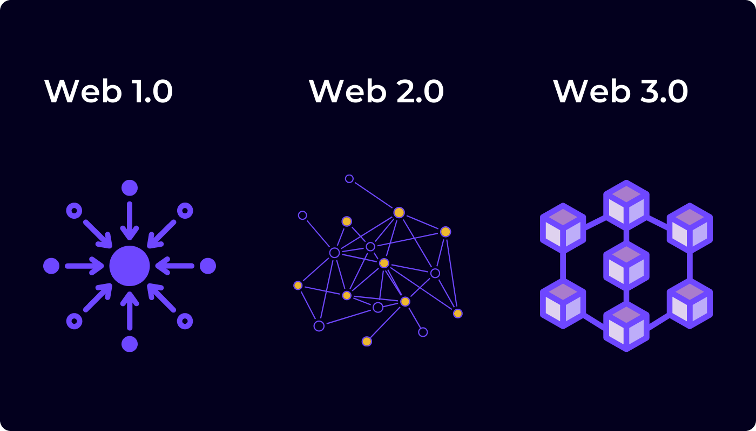
Platform details.

Slide 13
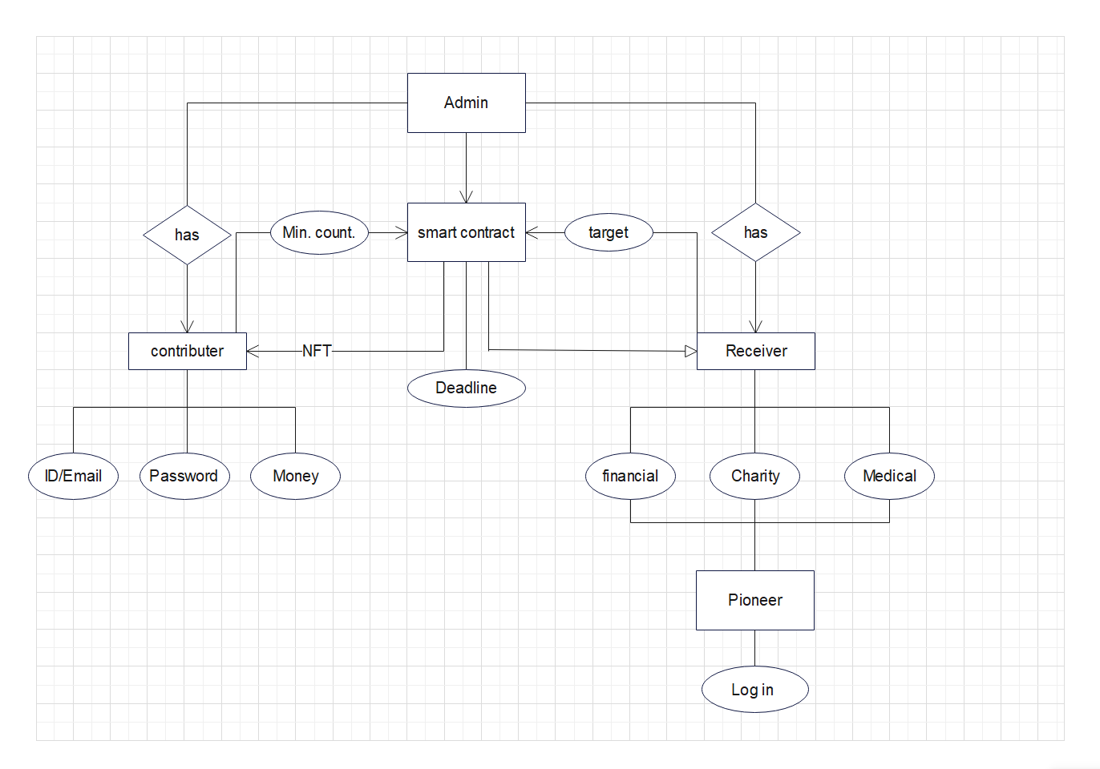

Slide 14
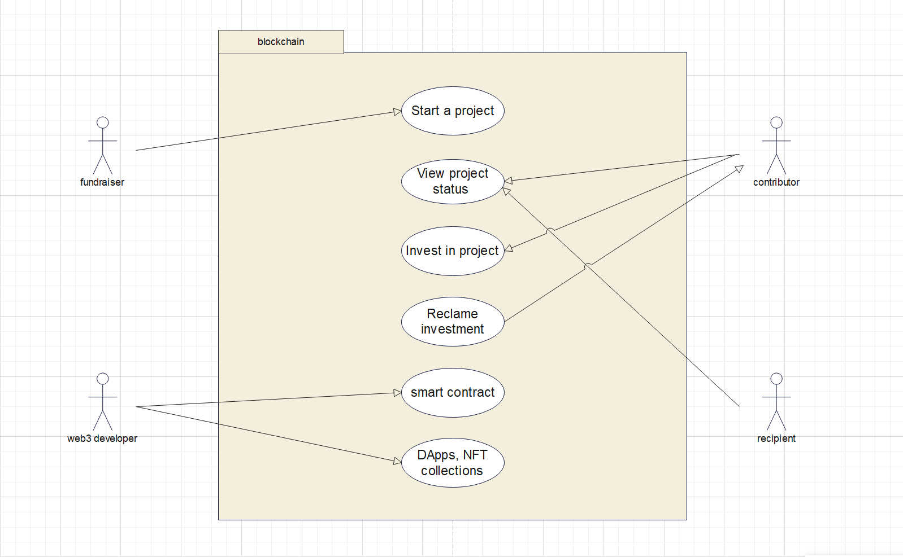

Slide 15
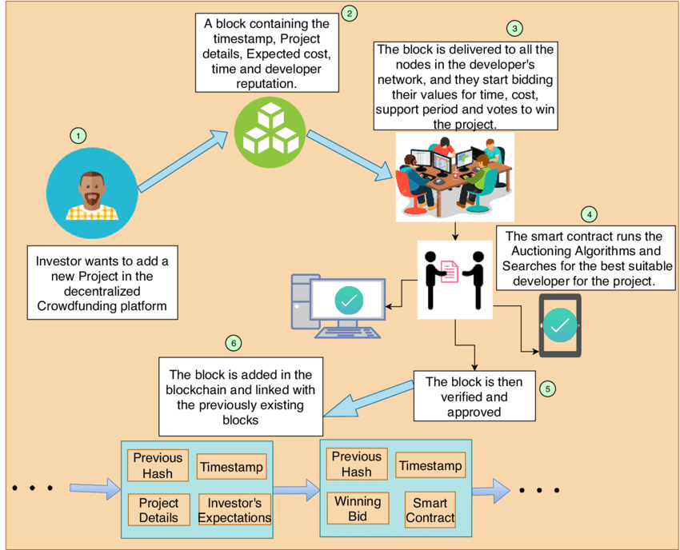

Slide 16
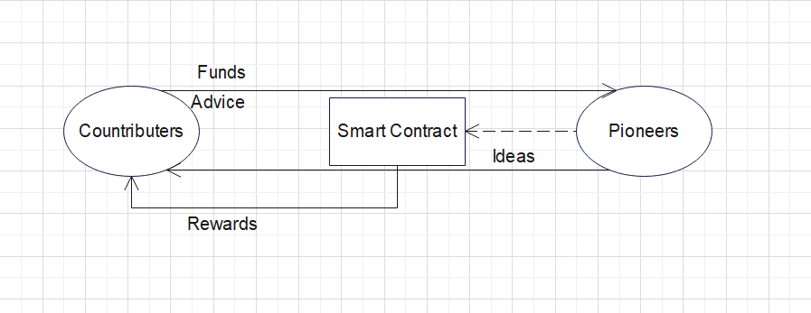

Slide 17
Proposed work
Problem Statement
Solutions
Required sources
We’ll reassure the user that their contribution/funds will indeed benefit the worthwhile cause.
We are gonna solve this problem by creating a platform using blockchain technology with the powerful technique by creating a powerful smart contract.
♦ solidity language ♦ Open Source
♦ Remix id ( Platform for solidity language) ♦ Smart Contract
♦ Front End & Back End ♦ Metamask Wallet
♦ Forum for Community ♦ Web 3.0

Slide 18
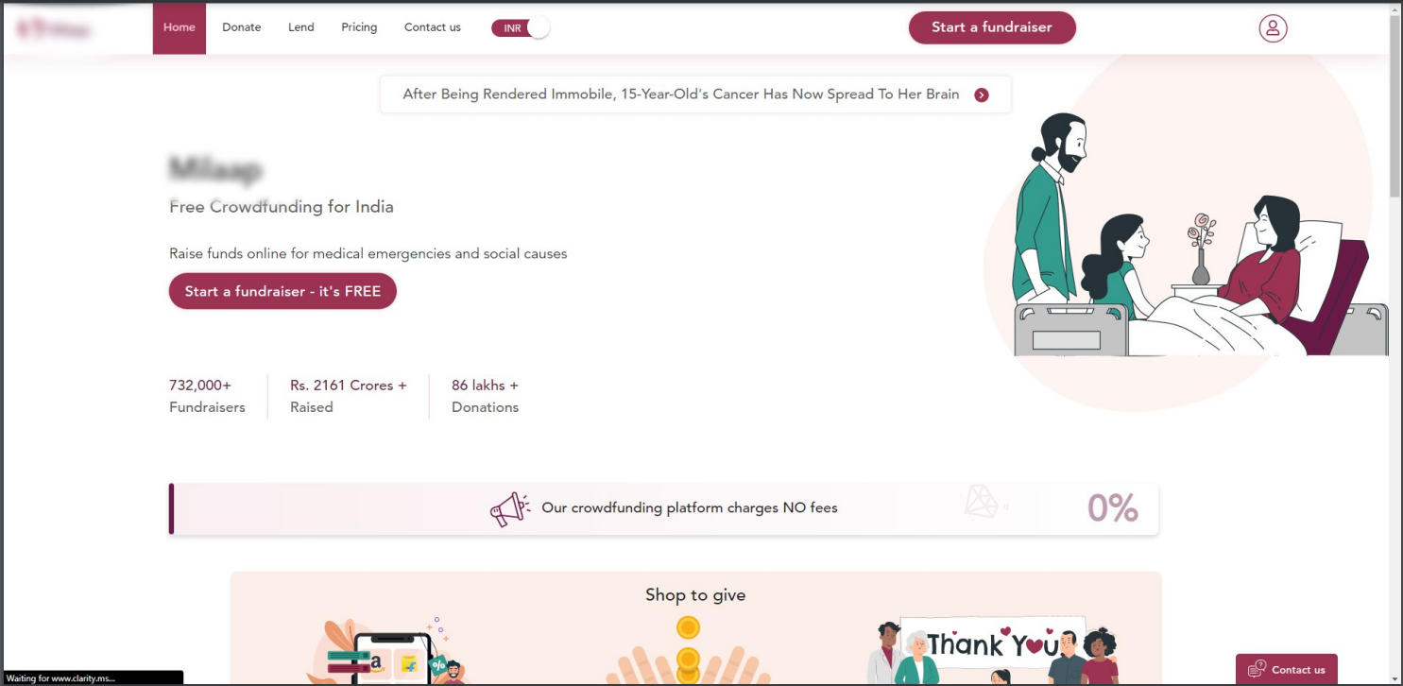

Slide 19
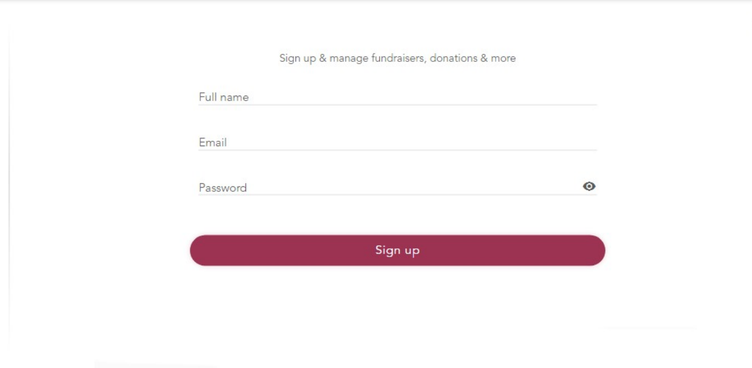

Slide 20
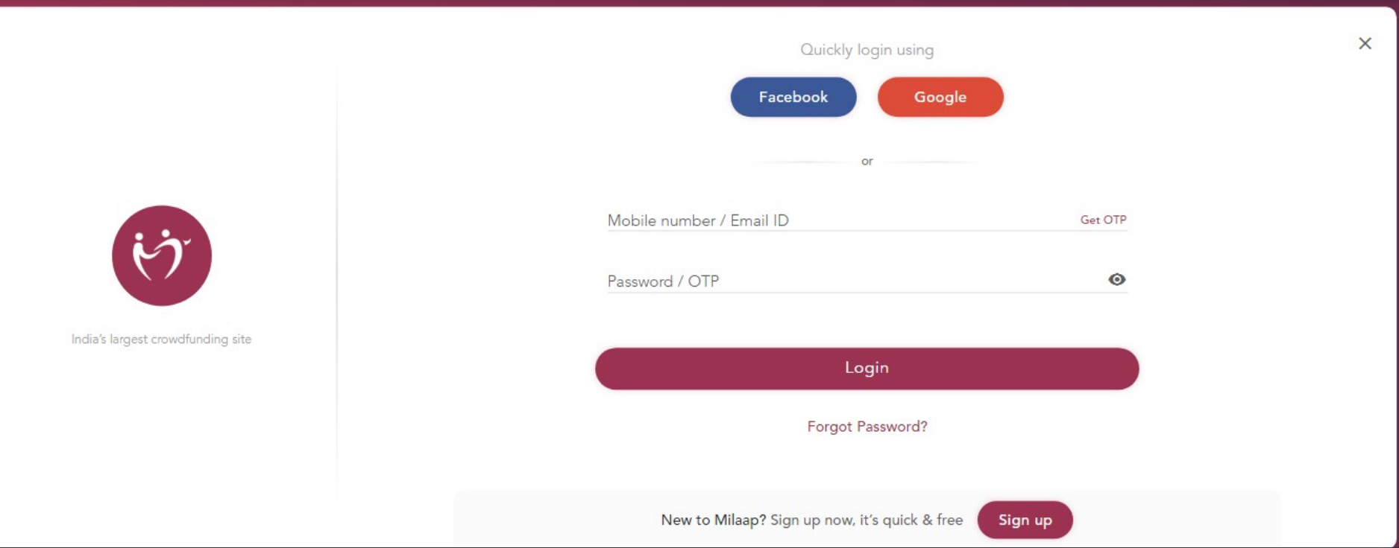

Slide 21
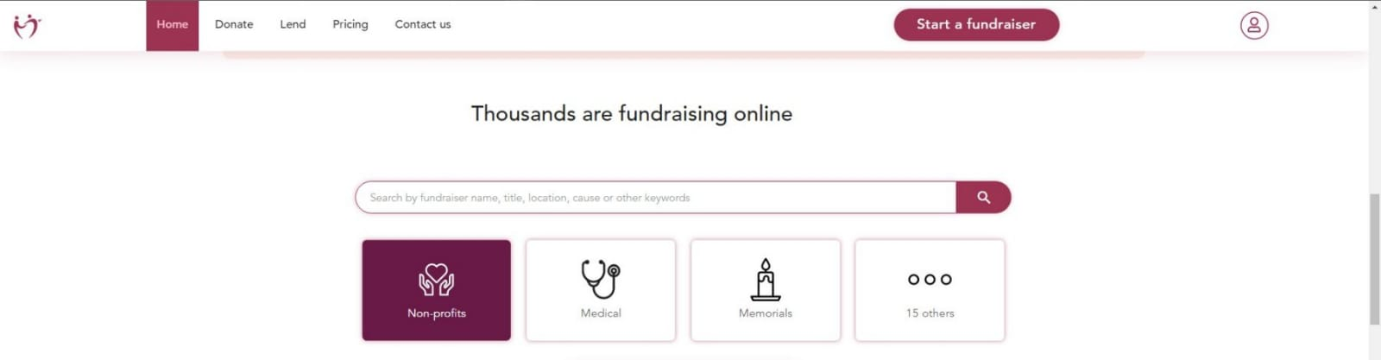
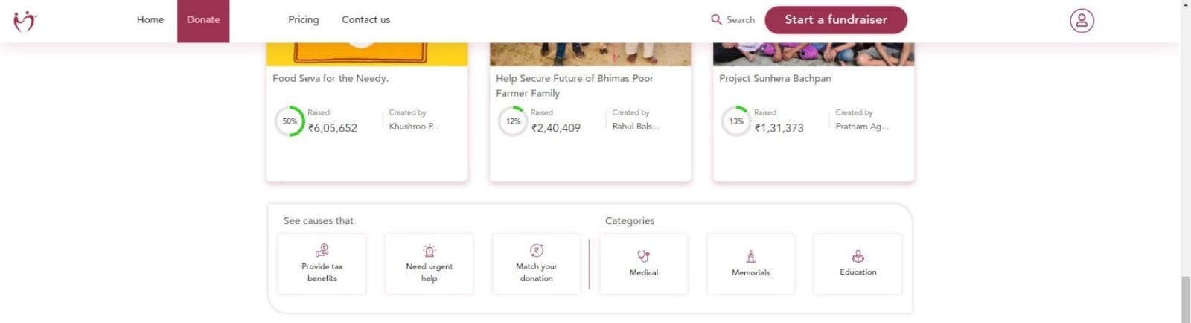

Slide 22
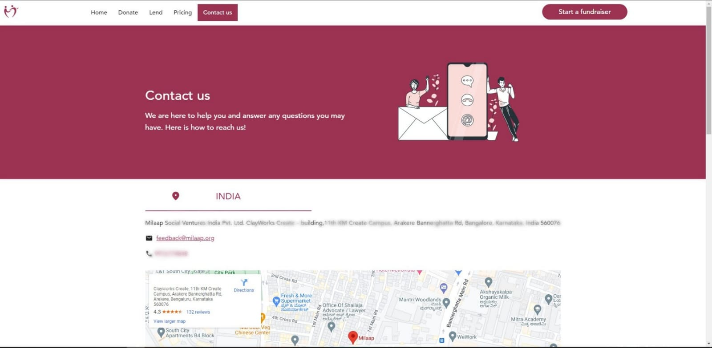

Slide 23

Rich people eats well, donating one's sleep well

Slide 24
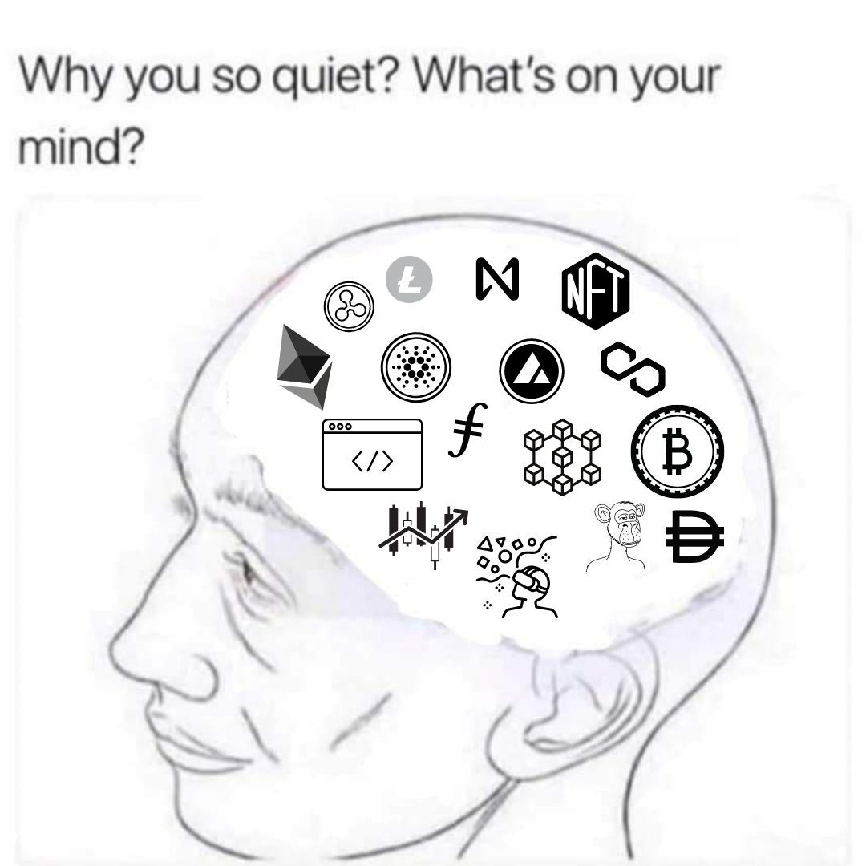
Do you have any questions?

Slide 25
Literature Review.
Sr.no | Origin | Authors | Date | Description
1
2
3

